Slide 1
Content Knowledge: The Key to 21st Century Learning
Presenter:
Michael Zwaagstra, BEd, PBCE, MEd, MA
Frontier Centre for Public Policy (fcpp.org)
Email: mzwaagstra@shaw.ca
Website: michaelzwaagstra.com
Twitter: @ZwaagstraM

Slide 2
21st Century Learning Quotes
“The world is changing faster than ever before.”
“We must prepare our students for jobs that do not even exist yet.”
“Educators become ‘Activators of Learning,’ creating a 21st Century culture and providing access to the supports and resources that learners need to succeed.”
“To reimagine education, teacher training requires a paradigm shift that goes beyond teaching students answers and instead teaching them how to ask the right questions, evaluate information critically, and communicate effectively.”

Slide 3
Common Features of 21st Century Learning
De-fronted classrooms
Teachers as learning facilitators
Project-based learning
Inquiry/discovery learning
Heavy use of technology and personal devices
Student group work
Interdisciplinary approach to subjects
Less emphasis on memorization

Slide 4
Who said this?
“The older teacher thought first of his subject matter, that it get learned…. The good teacher of the newer view well understands how it is the process itself, especially as socially conditioned, that educates; and he makes every effort to get and keep the process going on such terms as will cause it to gain in ever more certain and intelligently-directed momentum. This is his chief aim. That attained, the rest follows.”

Slide 5
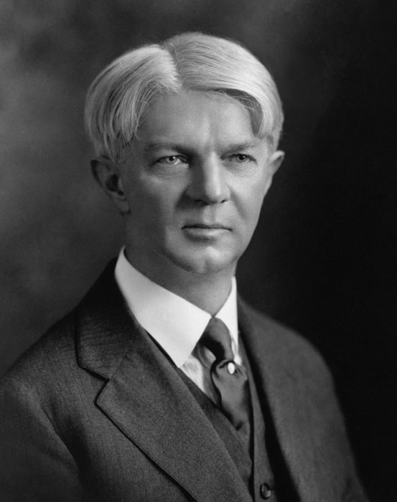
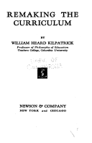
William Heard Kilpatrick
William Heard Kilpatrick, Remaking the Curriculum, 1936, pp. 55-56.
http://greatthoughtstreasury.com/author/william-kilpatrick-fully-william-heard-kilpatrick

Slide 6
“For teaching purposes, this older outlook customarily organized these items logically into subjects and assigned for the daily lesson some convenient subdivision for the subject…. In this discussion, this atomistic view of objectives, with its logical order of learning by separated subjects in long-range advance of actual use, is totally and wholly rejected as thoroughly misleading and mischievous, being in fact the antithetical opposite of the best available conceptions both of the life process and of learning. In contrast with such an atomistic and static conception of objectives the aim here is to set forth dynamic objectives inherently related to life as a process and therefore to natural and useful learning.” (pp. 108-109)

Slide 7
How New is 21st Century Learning?
“Today we live in a state of constant change. It is a technology-rich world, where communication is instant and information is immediately accessible. The way we interact with each other personally, socially, and at work has changed forever. Knowledge is growing and information is changing extremely quickly, creating new possibilities. This is the world our students are entering.”
BC Ministry of Education: https://curriculum.gov.bc.ca/curriculum-info (Accessed February 20, 2017)
“Am I wrong in thinking that education is changing now more than ever before? Life is vastly more complex in detail, and we are far more tied up with others about us even to our most distant neighbours.”
William Heard Kilpatrick, Foundations of Method, 1925.

Slide 8
Key Area of Concern
“What and how we teach our students has been redesigned to provide greater flexibility for teachers, while allowing space and time for students to develop their skills and explore their passions and interests. The deep understanding and application of knowledge is at the centre of the new model, as opposed to the memory and recall of facts that previously shaped education around the globe for many decades.”
BC Ministry of Education: https://curriculum.gov.bc.ca/curriculum-info (Accessed February 20, 2017)

Slide 9
Why Focusing on Content Knowledge is Important
It is essential for reading comprehension.
It makes critical thinking possible.
It empowers students from low-socioeconomic backgrounds.

Slide 10
Reading Comprehension
In order to become effective readers, students must be able to decode the text AND comprehend what they read.
Reading is not an abstract, transferable skill. Reading ability is closely linked to background knowledge.
The more you know about the topic of an article or book, the more likely you able to read and understand it.
Research evidence strongly backs up these points.

Slide 11
Research Study #1
Donna R. Recht and Lauren Leslie, “Effect of Prior Knowledge on Good and Poor Readers’ Memory of Text,” Journal of Educational Psychology 80, no. 1 (March 1988): 16 -20.
Key Finding
When reading an article about baseball, “poor” readers with background knowledge about baseball outperformed “good” readers who lacked this background knowledge.

Slide 12
Research Study #2
Wolfgang Schneider, Joachim Korkel, and Franz E. Weinert, “Domain-Specific Knowledge and Memory Performance: A Comparison of High- and Low-Aptitude Children,” Journal of Educational Psychology 81, no. 3 (1989): 306-312.
Key Finding
When reading an article about soccer, low-IQ students who knew a lot about soccer substantially outperformed high-IQ students who knew little about soccer.

Slide 13
Research Study #3
Diana J. Arya, Elfrieda H. Hiebert, and P. David Pearson, “The Effects of Syntactic and Lexical Complexity on the Comprehension of Elementary Science Texts,” International Electronic Journal of Elementary Education 4, no. 1 (2011): 107-125.
Key Finding
When reading about topics they already knew about, text complexity made little difference to accuracy or comprehension for third-grade students.

Slide 14
Critical Thinking
Critical thinking is NOT an abstract skill. Students can only think critically when they know something about the topic at hand.
A student who lacks background knowledge about the key provinces and individuals involved in Confederation of 1867 is unlikely to do much critical thinking about why Confederation happened the way it did.
While knowledge does not guarantee critical thinking, critical thinking is impossible without knowledge.
It remains important for students to memorize facts and have knowledge in their heads.

Slide 15
Research Study #1
Sacha Helfennstein and Pertti Saariluoma, “Mental Contents in Transfer,” Psychological Research 70, no. 4 (July 2006): 293-303.
Key Finding
Being able to solve a problem in one domain does not necessarily mean someone can solve a similar problem in a different domain. Specific content knowledge is essential to problem-solving.

Slide 16
Research Study #2
D. N. Perkins and Gavriel Saloman, “Are Cognitive Skills Context Bound?” Educational Researcher 18 No. 1 (January 1989): 16-25.
Key Finding
“In the synthesis, general cognitive skills do not function by somehow taking the place of domain-specific knowledge, nor by operating the same way from domain to domain.”

Slide 17
Research Study #3
Jill Larkin et al., “Expert and Novice Performance in Solving Physics Problems,” Science 208 (1980): 1335-1342.
Key Finding
Subject-matter experts benefit far more from looking things up than novices do. Making additional information readily accessible is less helpful than developing domain-specific expertise.

Slide 18
Empowering Disadvantaged Students
Low socioeconomic status (SES) students enter school with a more limited vocabulary and shallower knowledge base than high SES students.
The early grades are the essential time to impart specific knowledge to all students.
Low SES students benefit the most from content-rich instruction since they gain knowledge they would not have received otherwise.
The more a student knows, the more they are able to learn.

Slide 19
Research Study #1
Erika Hoff, “The Specificity of Environmental Influence: Socioeconomic Status Affects Early Vocabulary Development Via Maternal Speech,” Child Development 74, no. 5 (September/October 2003): 1368-1378.
Key Finding
“In conclusion, common belief and scientific evidence are in agreement that children from more advantaged homes have more advanced language skills than children of the same age from less advantaged homes.”

Slide 20
Research Study #2
Keith E. Stanovich, “Matthew Effects in Reading: Some Consequences of Individual Differences in the Acquisition of Literacy,” Reading Research Quarterly (Fall 1986): 360-407.
Key Finding
“Children with inadequate vocabularies—who read slowly and without enjoyment—read less, and as a result have slower development of vocabulary knowledge, which inhibits further growth in reading ability.”

Slide 21
Research Study #3
Susan Sonnenschein, Linda Baker, and Adia Garrett, “An Analysis of Academic Progress of Children Participating in the Core Knowledge Preschool Program in Baltimore County Head Start Centers,” (August 2005): 1-49.
Key Finding
“The results of this evaluation show that the Core Knowledge Preschool Sequence as implemented in the Baltimore County Head Start centers is successful in providing low income children with the skills and knowledge that children of their age across the country are expected to master.”

Slide 22
PS 124 in Queens, New York
www.ps124q.com

Slide 23
Recommended Resources
There are many excellent books, articles, and websites that provide support to teachers and administrators who wish to learn more about the importance of content knowledge.
Unfortunately, much of the educational literature currently distributed to teachers lacks a proper balance on this issue.
Here are some recommended resources:

Slide 24
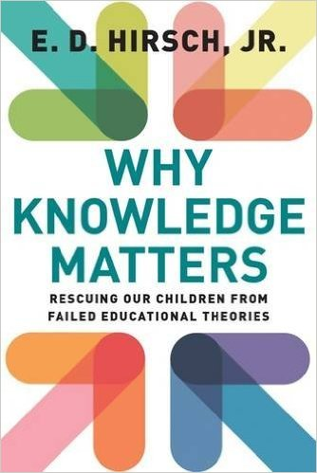
E. D. Hirsch, Jr., Why Knowledge Matters: Rescuing Our Children from Failed Educational Theories, 2016
Hirsch’s organization, The Core Knowledge Foundation, provides the template for a content-rich curriculum.
www.coreknowledge.org
https://www.amazon.ca/Why-Knowledge-Matters-Rescuing-Educational/dp/1612509525

Slide 25
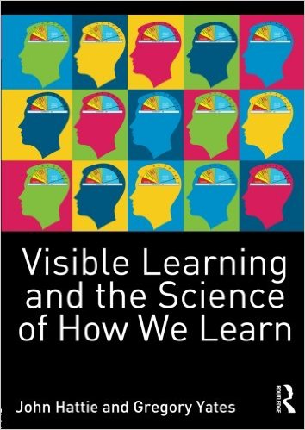
John Hattie and Gregory Yates, Visible Learning and the Science of How We Learn, 2014.
https://www.amazon.ca/Visible-Learning-Science-How-Learn/dp/0415704995

Slide 26
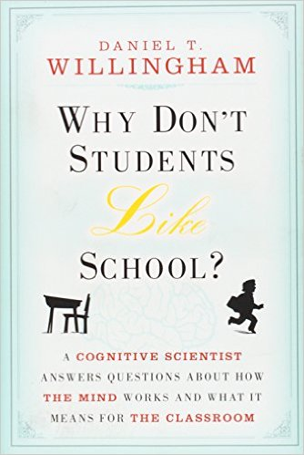
Daniel T. Willingham, Why Don’t Students Like School? A Cognitive Scientist Answers Questions About How the Mind Works and What It Means for the Classroom, 2009.
https://www.amazon.ca/Why-Dont-Students-Like-School/dp/047059196X

Slide 27
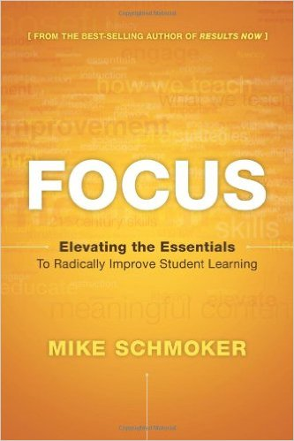
Mike Schmoker, Focus: Elevating the Essentials to Radically Improve Student Learning, 2011.
https://www.amazon.ca/Focus-Elevating-Essentials-Radically-Learning/dp/1416611304

Slide 28
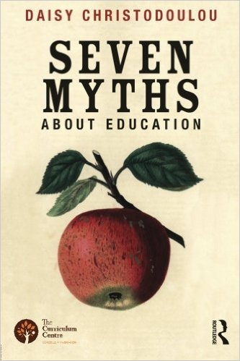
Daisy Christodoulou, Seven Myths About Education, 2014.
https://www.amazon.ca/Seven-Myths-About-Education-Christodoulou/dp/0415746825

Slide 29
Michael C. Zwaagstra, Rodney A. Clifton, and John C. Long, What’s Wrong With Our Schools and How We Can Fix Them, 2010.
https://www.amazon.ca/Whats-Wrong-Our-Schools-Them/dp/1607091585

Slide 30
Concluding Thoughts
Remember that the key ideas being promoted by the 21st Century Learning movement are not new.
While content knowledge is often dismissed as secondary in importance, the reality is that knowledge is just as important as ever.
Content knowledge is essential for reading comprehension, makes critical thinking possible, and empowers low SES students.
There are good reasons for teachers to directly provide substantial content knowledge to their students.

Slide 31
Thank You for Your Attention!
Contact Information for Michael Zwaagstra:
Phone: 204-371-5125
Email: mzwaagstra@shaw.ca
Website: michaelzwaagstra.com
Twitter: @ZwaagstraM

